Slide 1
Automated Demand Analysis & Strategy: Bike-Sharing Program
Uncovering Time, User, and Weather-Based Rental Patterns
A project by Next Hike Solution
Prepared by:
Chhobi Sharma / October 2025

Slide 2
Executive Summary (The Takeaway)
Headline: Core Insight: Demand is driven by Registered Commuters, peaking reliably at rush hours.
Key Finding 1 (Time): High-volume peaks occur at 8 AM and 5 PM (commute times).
Key Finding 2 (User Type): Registered users are the primary revenue source, while Casual users dominate leisure time (weekends/holidays).
Key Finding 3 (Weather): Temperature has a weak positive correlation with demand, while bad weather significantly reduces volume.
Main Recommendation: Implement dynamic fleet redistribution 30 minutes before each rush hour peak.

Slide 3
Project Goal & Methodology
Goal : To build an automated reporting solution that identifies key drivers of rental demand for better operational planning.
Data Used: Hourly bike-sharing data (hr, cnt , weathersit, season).
Methodology:
Data Cleaning & Transformation (e.g., creating Season Name, Weather_Desc).
Advanced Analysis: Pivot Tables, Correlation Analysis, Custom Calculations (e.g., Total Rainy Day Rentals: 2,825).
Deliverable: Automated Dashboard (Excel) and Strategic Report.

Slide 4
Finding 1: Hourly Demand Pattern
Headline: Peak Demand is Commute-Driven
Key Points:
Morning Peak (8 AM) and Evening Peak (5 PM).
Sharp drop-off during 1 AM - 5 AM.
Strategic Implication: Ensure maximum inventory at high-demand stations during peak hours.

Slide 5
Finding 2: User Segmentation & Behavior
Headline: Registered Users are the Volume Base; Casual Users are Weekend/Leisure.
Key Points:
Registered: High weekday use (especially Thursday/Friday).
Casual: Higher use on Saturday/Sunday.
Strategic Implication: Target Registered users with loyalty programs; use weekend promotions for Casual users.

Slide 6
Finding 3: Environmental Factors
Headline: Weather is a Deterrent; Temperature is a Minor Factor.
Key Points:
Correlation: Temperature (+0.23), Humidity (-0.25).
Bad weather drastically reduces demand (2,825 rentals on bad days).
Strategic Implication: Reduce staffing or shift to maintenance on predicted bad weather days.

Slide 7
The Automated Solution (The Dashboard)
Headline: Dynamic Reporting for Instant Decision-Making
Key Features:
Interactivity: Slicers (Weather Desc., Day of Week) for instant filtering.
Automation: One-click data refresh for updates.

Slide 8
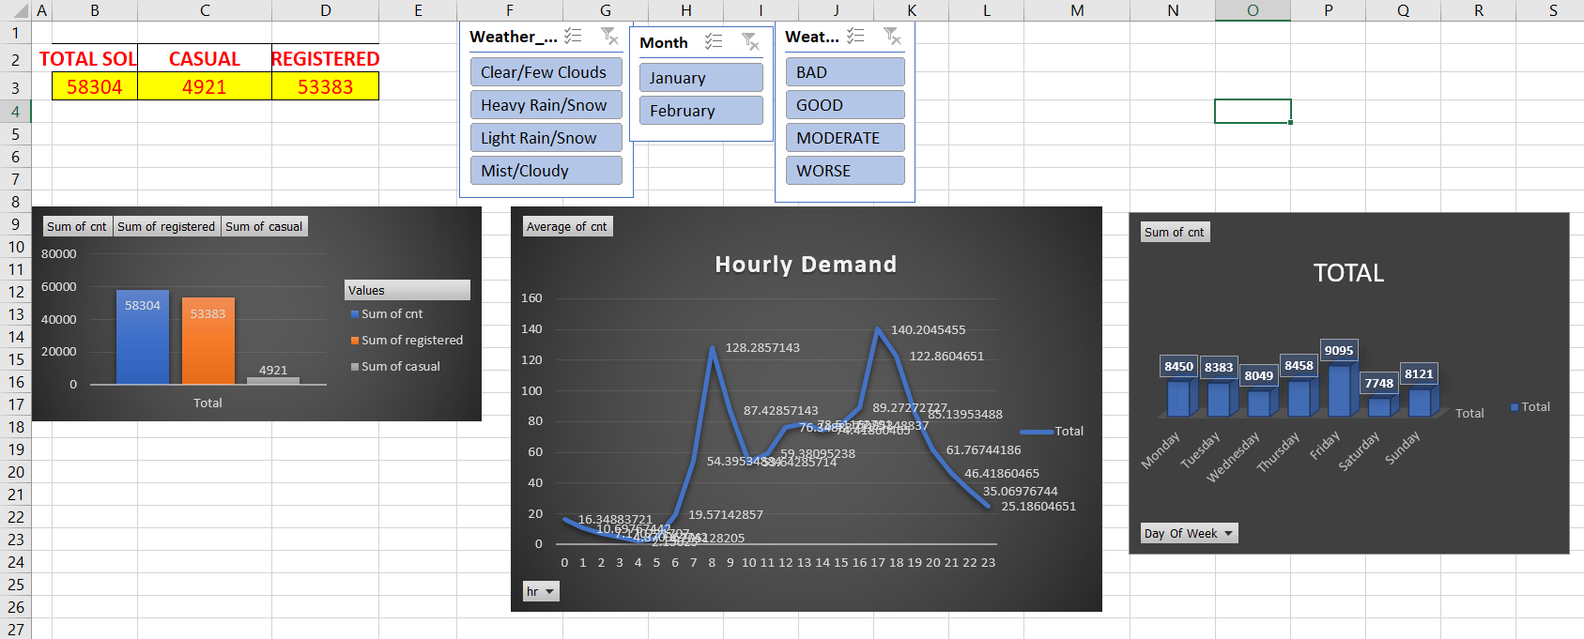
DASHBOARD

Slide 9
Strategic Recommendations
Recommendation 1: Dynamic Fleet Management
• Action: Reallocate bikes from low-demand zones to high-demand zones at 7:30 AM and 4:30 PM.
• Benefit: Maximize availability during 8 AM / 5 PM peaks.
Recommendation 2: Targeted Marketing
• Action: Weekend discounts to convert Casual use to subscriptions.
• Benefit: Boost leisure revenue.
Recommendation 3: Maintenance Scheduling
• Action: Schedule maintenance during low-demand hours or bad weather.
• Benefit: Minimize peak disruption.

Slide 10
Thank You
Contact: Chhobi Sharma
Phone: +91 8254824774
Thank You!

